Slide 1



MULTIMEDIA
DATABASE
KLEART ADRI

Slide 2

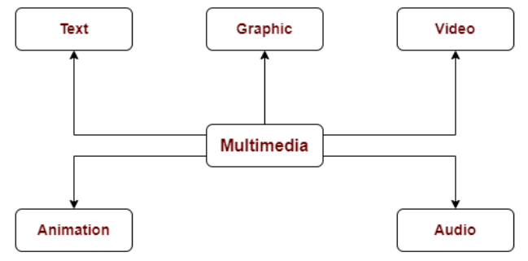
INTRODUCTION TO MULTIMEDIA DB
Multimedia data enables information to be represented through text, audio, graphics, image, animation, and video…

Slide 3
TYPES
Text and documents
  Include: words, sentences, paragraphs, …, structure, link, etc. (e.g., xml/html tags, hyperlink)
  Now also include (micro)blogs, SMS
  Image and graphics
  Digital equivalents of drawings, paintings, photographs (including medical imaging), or prints
  Audio and video
  Considers temporal characteristics
  Speech
  Audio in natural language
  Speech-to-text and text-to-speech tools

Slide 4
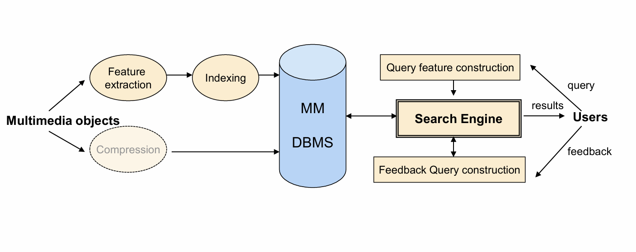
THE PROBLEM WITH TRADITIONAL SYSTEMS

Slide 5

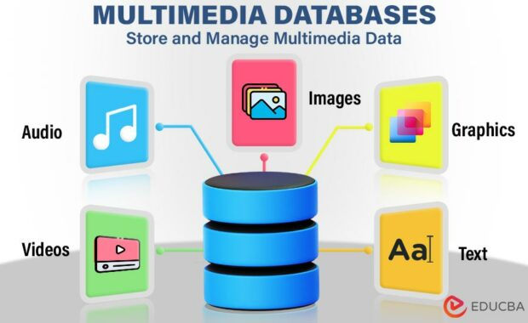
USAGE
  Store and manage images, audio, video, and graphics
  Organize multimedia using metadata
  Support efficient multimedia searching and retrieval
  Handle large and complex multimedia data
  Enable content-based search (image, video, audio)
  Used in media, entertainment, and advertising
  Applied in education and e-learning systems
  Support modern applications beyond traditional RDBMS

Slide 6
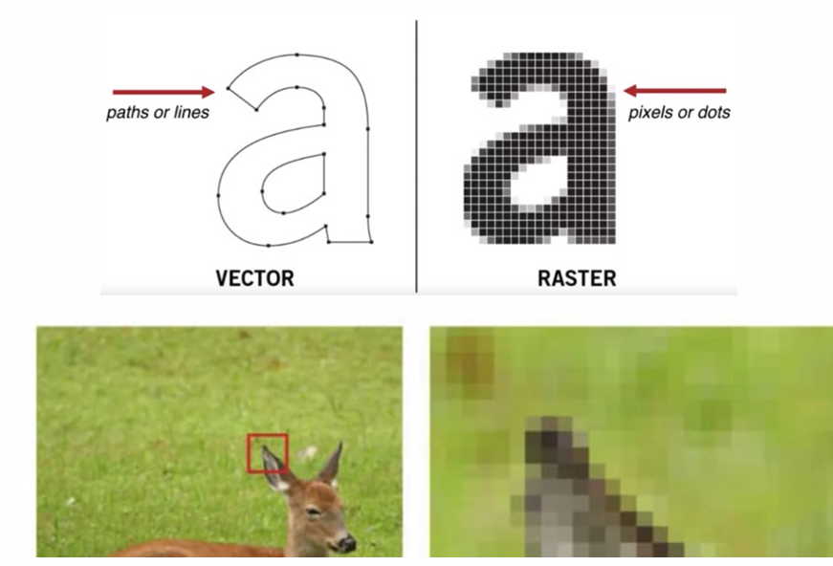
IMAGE DATA

Slide 7
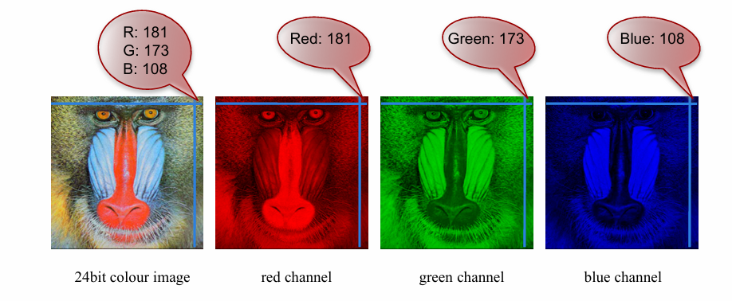
JPF FORMAT
Each pixel is represented by 3 bytes  24-bits, supporting 256 × 256 × 256 possible combined colors (or 16,777,216 different colors)
A 640 × 480 24-bit colour image requires 921.6 KB of storage (without compression)

Slide 8
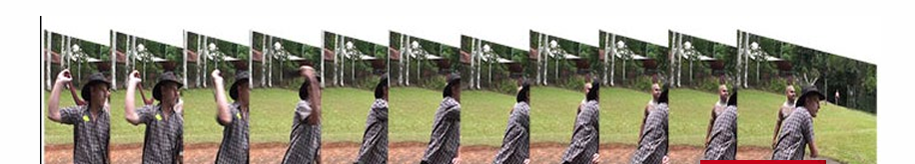
VIDEO
Video is a sequence of pictures …
  Analog
  Some with rich information such as sound, text, annotations and metadata…
Compression
  30 frames/sec
  Resolution: 640 × 480
  24-bit RGB  Storage: ~26 Mbytes/sec (uncompressed)
  Most likely in compressed forms

Slide 9
MY PROJECT OVERVIEW
This project is a Multimedia Database Management System (Multimedia DBMS) designed to store, manage, and search multimedia data such as images and related metadata. The system combines a Python-based environment, specialized libraries for multimedia processing, and a structured database for efficient data storage and retrieval.

Slide 10
DEVELOPMENT ENVIRONMENT
•Software Requirements:
- Python 3.x
- PostgreSQL with pgvector extension
- Flask, SQLAlchemy, OpenCV, Librosa, PyTorch
Hardware Requirements:
- Adequate storage for multimedia files
- Optional GPU for deep feature extraction acceleration

Slide 11
WHAT IS POSTGRESQL?
•PostgreSQL is an advanced open-source relational database management system.
•It supports extensibility, custom data types, and powerful indexing mechanisms.
•It is widely used for scalable, secure, and high-performance applications.
•PostgreSQL supports extensions such as pgvector for vector similarity search.

Slide 12
PGVECTOR EXTENSION IN POSTGRESQL
pgvector is a PostgreSQL extension that allows storing and searching vector embeddings.
It is used to store feature vectors extracted from multimedia files.
Supports similarity search using:
- Euclidean distance
- Cosine similarity
- Manhattan distance
•Enables efficient K-Nearest Neighbor (KNN) queries.

Slide 13
SYSTEM ARCHITECTURE
The system consists of the following layers:
1. Frontend (User Interface)
2. Backend API (Flask Server)
3. PostgreSQL Database with pgvector
4. Feature Extraction Modules
Media is uploaded, processed into vectors, stored, and later searched using similarity queries.

Slide 14
FEATURE EXTRACTION PROCESS
Each multimedia file is processed to extract numerical features:
- Images: color histogram, texture (LBP), deep CNN features
- Audio: MFCC, spectral features, waveform statistics
- Video: keyframes, motion features, scene statistics
These features are converted into fixed-length vector embeddings.

Slide 15
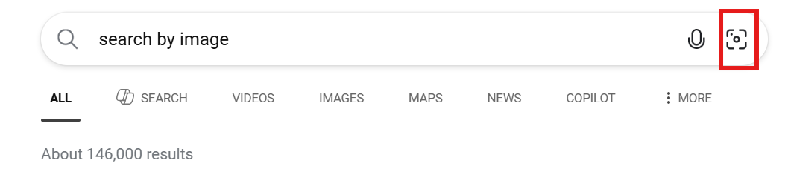
FUTURE WORK
  At the current stage, the system only supports image upload and storage.
  Images are stored on disk and basic metadata is saved in the database.
  No image analysis or similarity search is implemented yet.
  TensorFlow will be used to extract numerical feature vectors from images.
  The database will be populated with these feature vectors after image upload or during batch processing.
  K-Nearest Neighbors (KNN) will be applied to compare image feature vectors.
  The system will support Query By Example, using a query image.

Slide 16
THANK YOU

